Slide 1


Deep Regression Representation Learning with Topology
Shihao Zhang, Kenji Kawaguchi, Angela Yao
ICML 2024

Slide 2
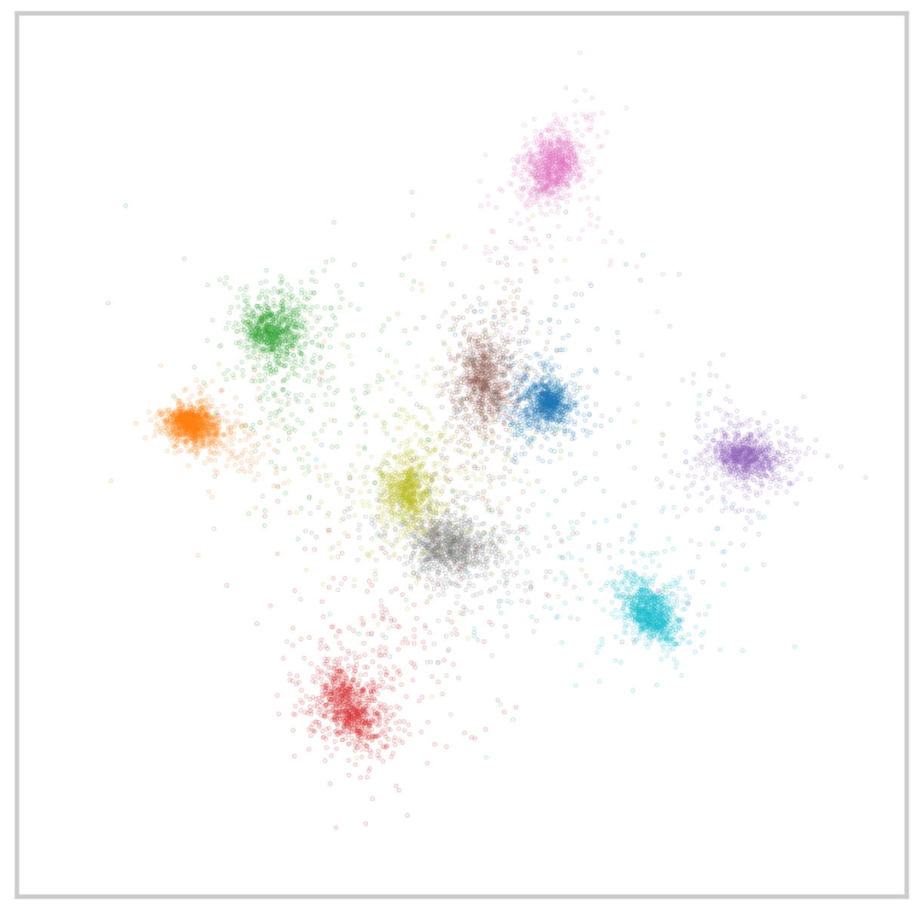
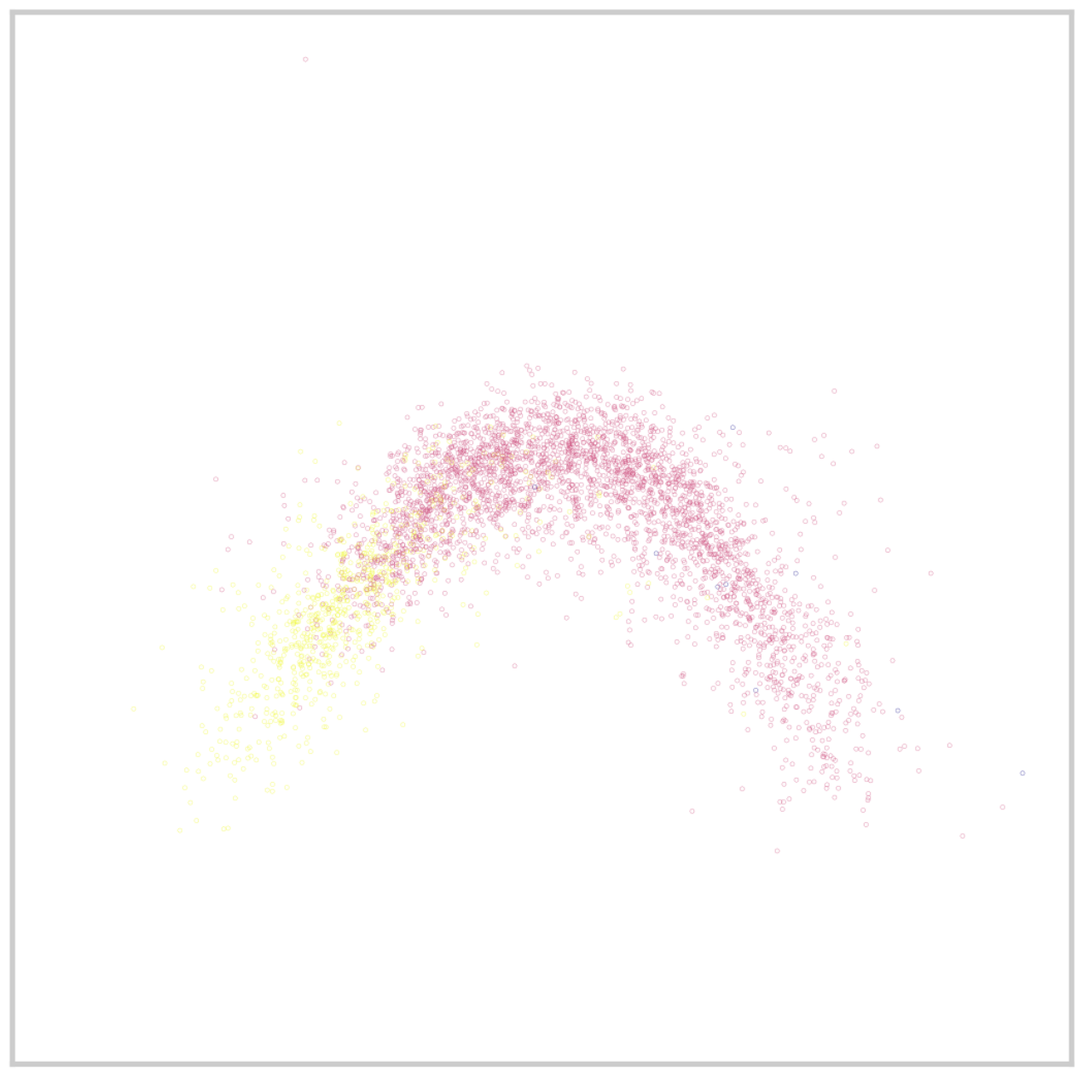

Motivation
Classification
Regression
The representation topologies of classification and regression are different:
Classification: disconnected
Regression: connected
What topology (shape) the representations should have for effective regression?
2

Slide 3
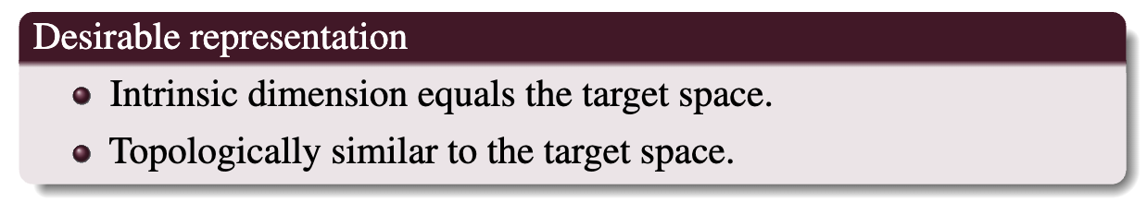
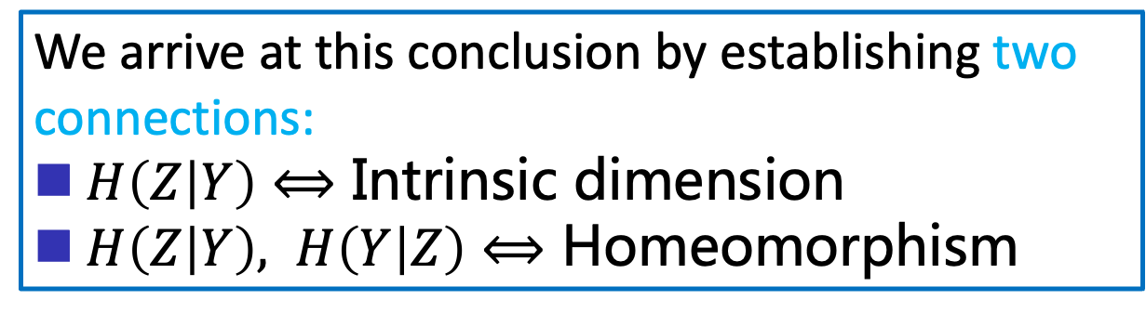
We arrive at this conclusion by establishing two connections:
$H\left(Z | Y\right)⟺$ Intrinsic dimension
$H\left(Z | Y\right), H\left(Y | Z\right)⟺$ Homeomorphism

Slide 4
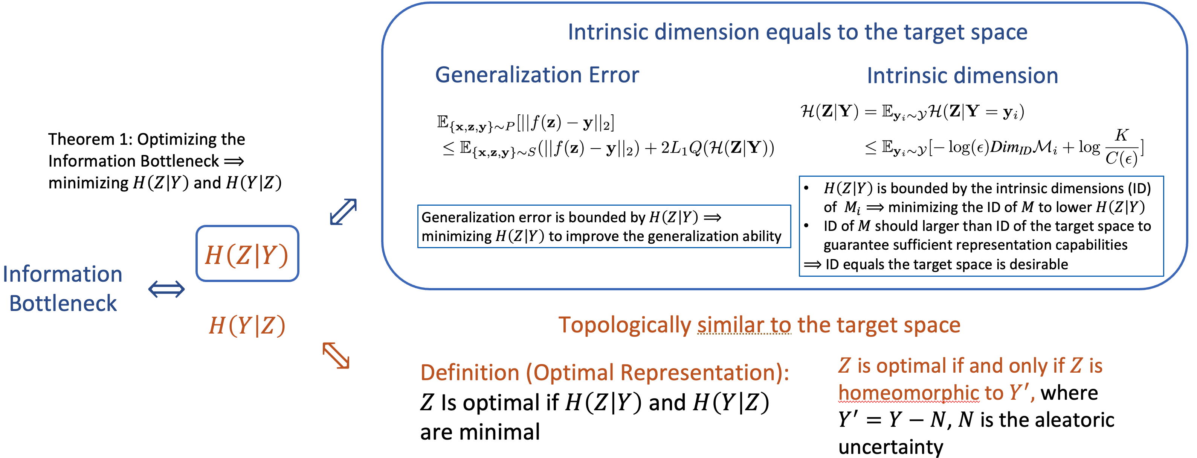

Slide 5
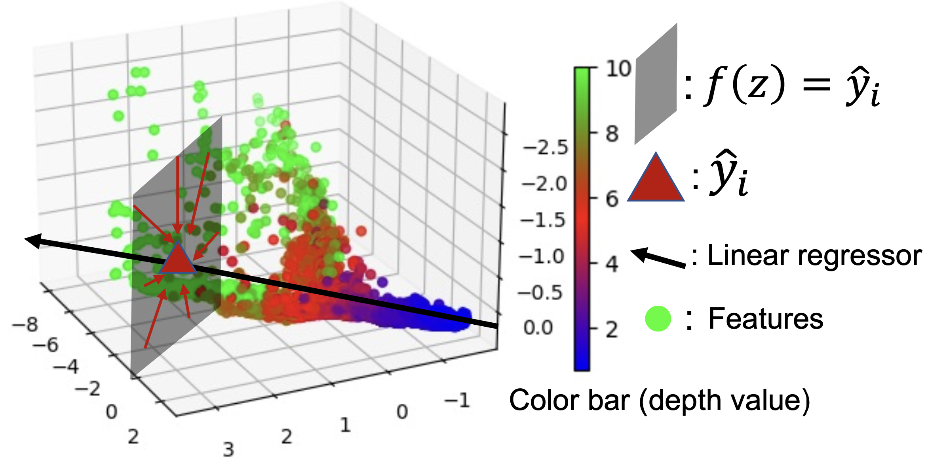
Encouraging the Same Intrinsic Dimension
Lowering the intrinsic dimension results in a lower H(Z|Y), implying a higher generalization ability.

Slide 6

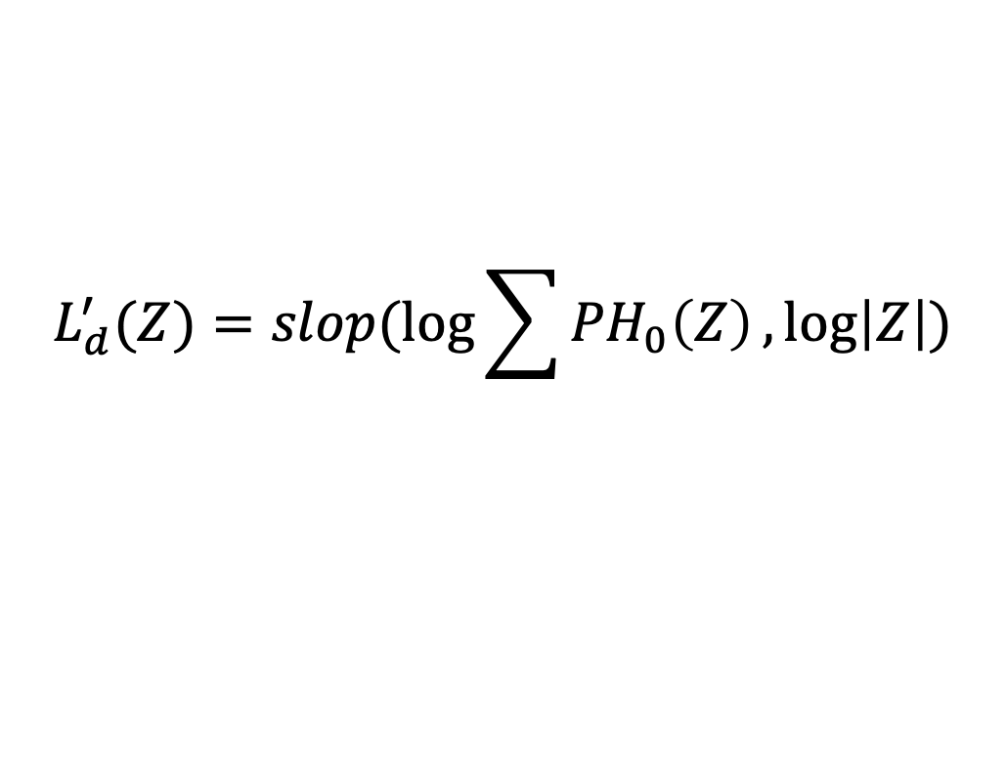
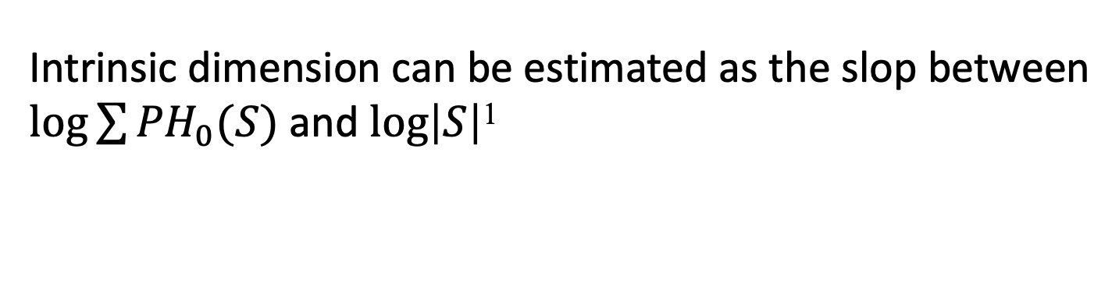
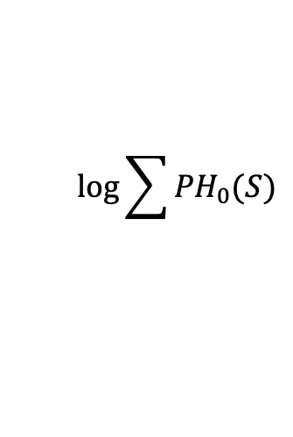
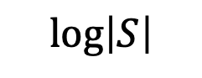
Encouraging the Same Intrinsic Dimension
$$log⁡\sum{{PH}_{0}(S)}$$
$$0$$
$$log⁡\left|S\right|$$
Intrinsic dimension can be estimated as the slop between $log⁡\sum{{PH}_{0}(S)}$ and $log⁡\left|S\right|$¹
Encourage a lower intrinsic dimension:
$$L_{d}^{′}(Z)=slop(\log{\sum{{PH}_{0}\left(Z\right)}},log⁡\left|Z\right|)$$
Encourage the same intrinsic dimension:
$$L_{d}={|L}_{d}^{′}(Z)/L_{d}^{′}(Y)|$$
¹Intrinsic Dimension, Persistent Homology and Generalization in Neural Networks, Birdal et al. NeurIPS. 2021

Slide 7
Enforcing Topological Similarity
Feature and target spaces are topologically similar, and enforcing such similarity is helpful.

Slide 8
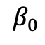
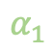
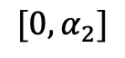
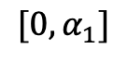

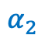
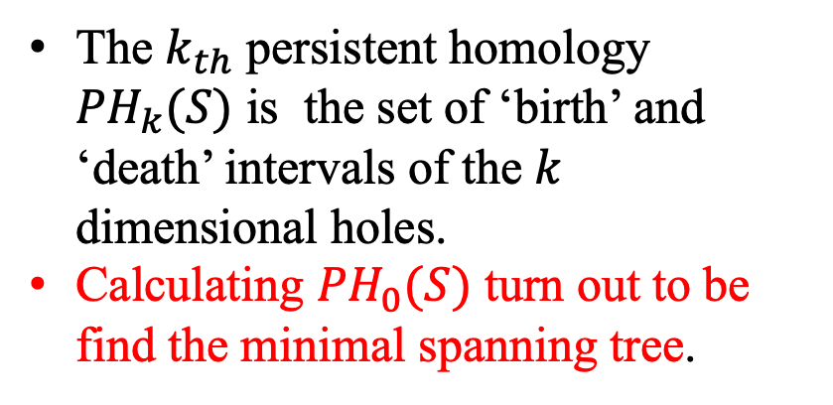
Enforcing Topological Similarity
Death
The $k_{th}$ persistent homology ${PH}_{k}(S)$ is the set of ‘birth’ and ‘death’ intervals of the $k$ dimensional holes.
Calculating ${PH}_{0}(S)$ turn out to be find the minimal spanning tree.
$$β_{0}$$
[‘birth’, ‘death’]
$$α_{2}$$
$${[0,α}_{1}]$$
$$α_{1}$$
$${[0,α}_{2}]$$
$$0$$
Birth
‘birth’ and ‘death’ threshold
Enforcing topological similarity:
$$L_{t}={||Z\left({edge}_{z}\right)−Y({edge}_{z})||}_{2}^{2}+{||Z\left({edge}_{y}\right)−Y({edge}_{y})||}_{2}^{2}$$
Topological Autoencoders, Moor et al. ICML. 2021

Slide 9
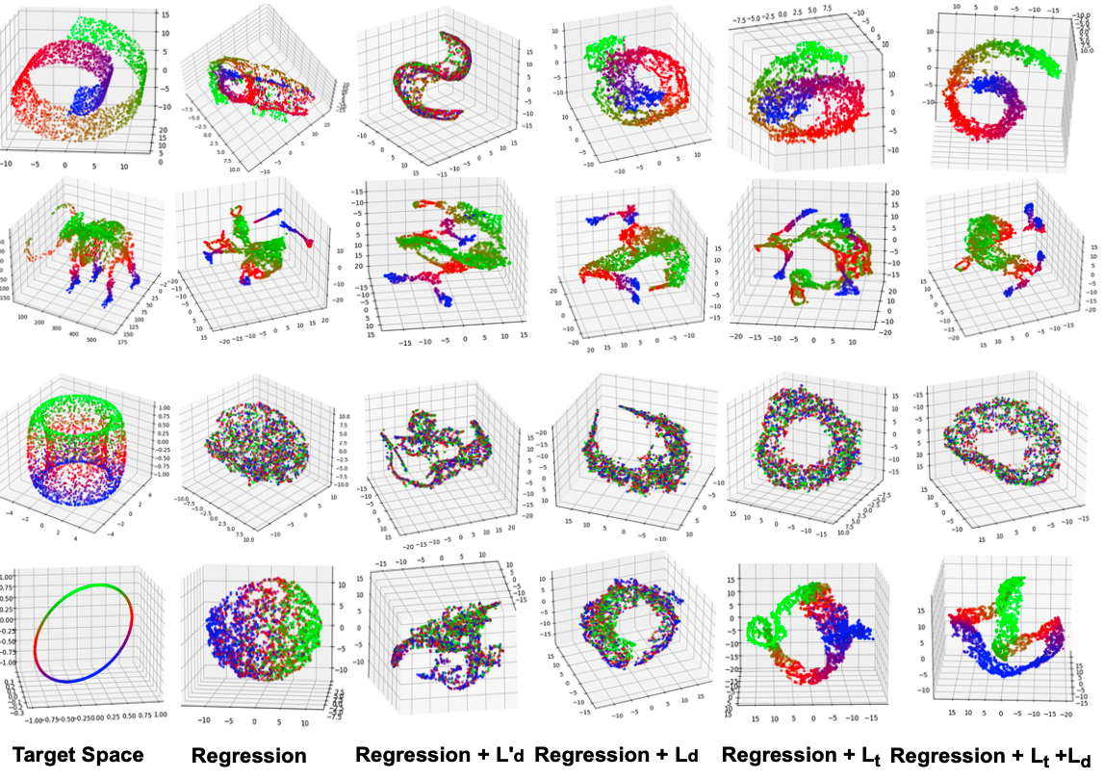
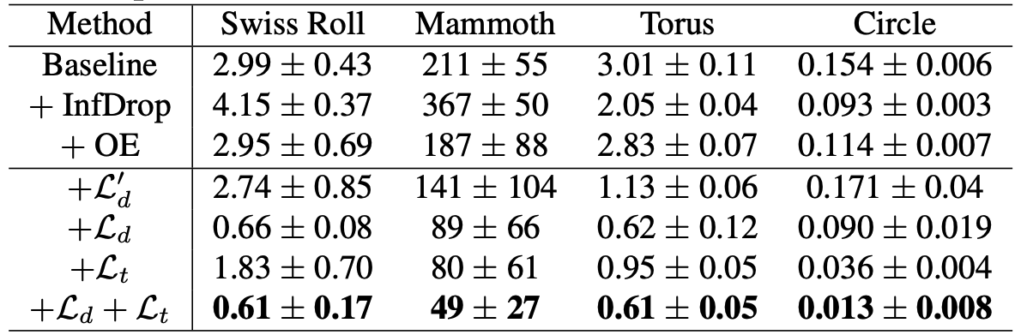

Slide 10
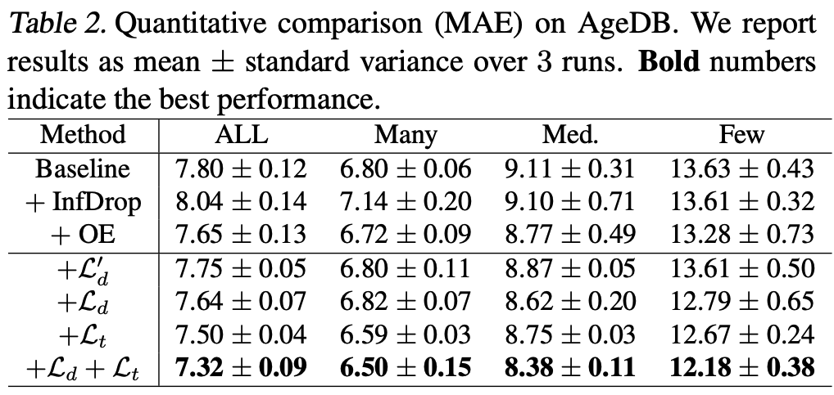

Slide 11
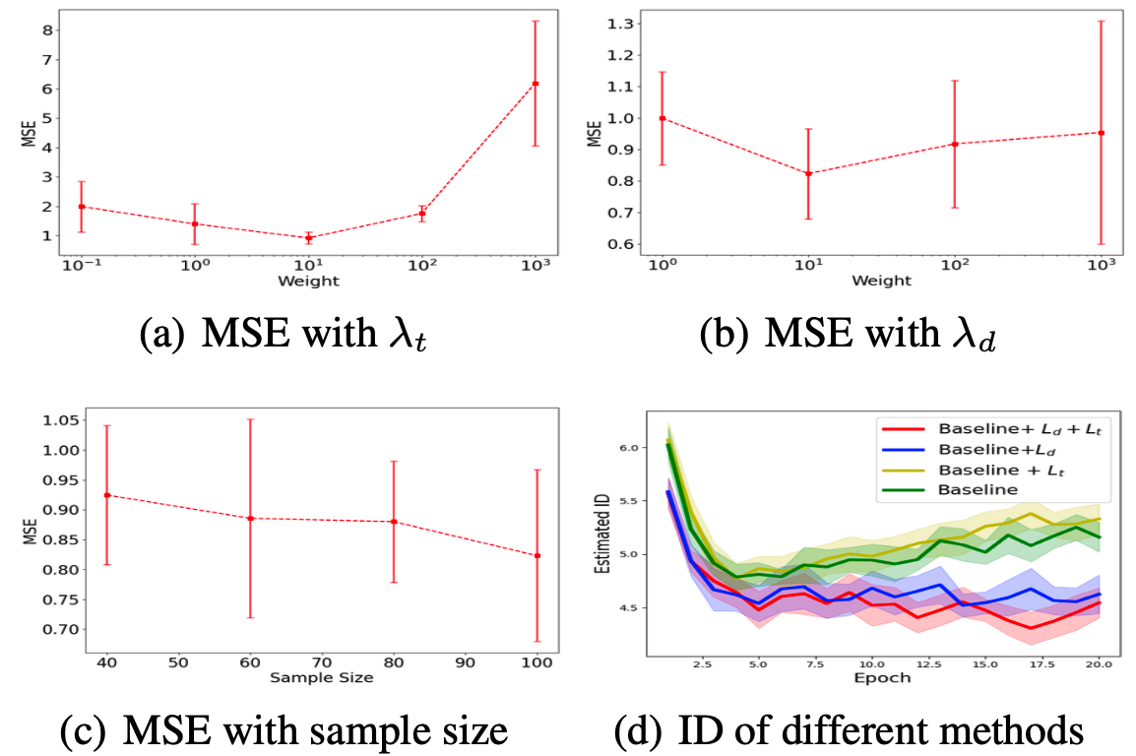

Slide 12
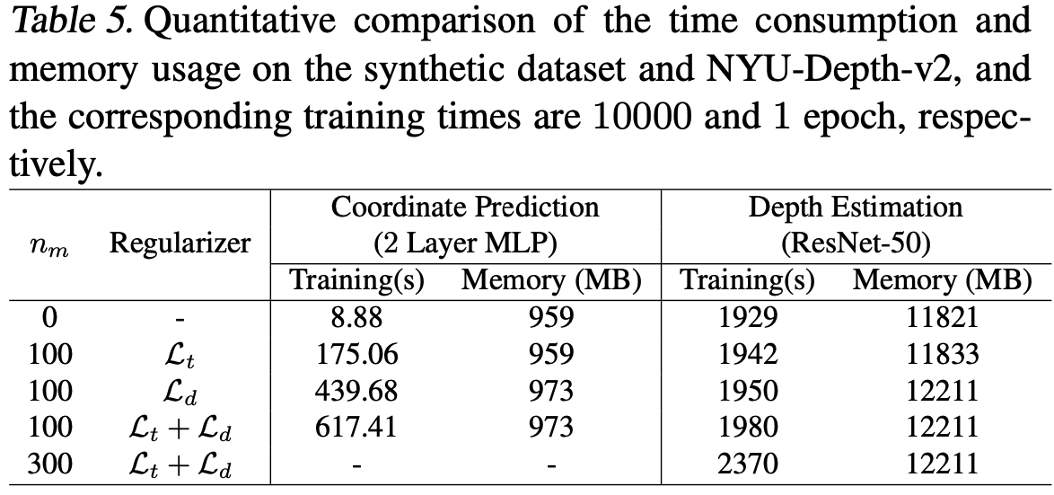

Slide 13
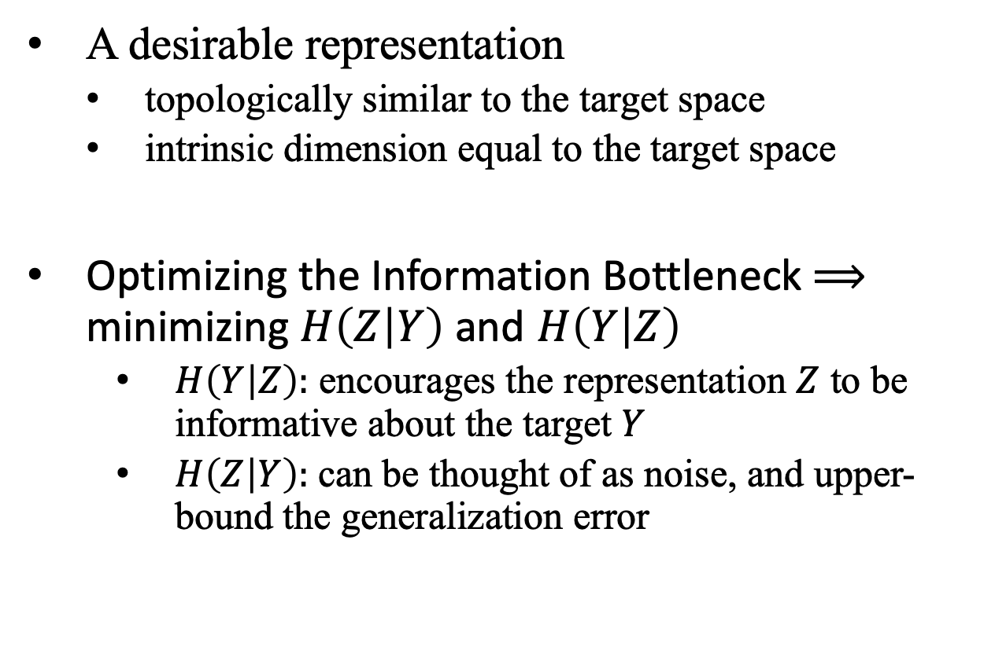
Conclusion
A desirable representation
topologically similar to the target space
intrinsic dimension equal to the target space
Optimizing the Information Bottleneck $⟹$ minimizing $H\left(Z | Y\right)$ and $H\left(Y | Z\right)$
$H\left(Y | Z\right):$ encourages the representation $Z$ to be informative about the target $Y$
$H\left(Z | Y\right):$can be thought of as noise, and upper-bound the generalization error
13

